Slide 1













SELF-CHECKOUT SYSTEM
LAM YOKE YU | A23CS0233
GOE JIE YING | A23CS0224
TEH RU QIAN | A23CS0191
TAN YI YA | A23CS0187

Slide 2
TABLE OF CONTENTS
01
02
SYNOPSIS AND GENERAL IDEA
INTRODUCTION
03
EXPECTED OUTPUT
04
STORYBOARD
05
06
POSSIBLE IMPROVEMENT
CONCLUSION

Slide 3
INTRODUCTION
01
A brief introduction about Self-Checkout System

Slide 4

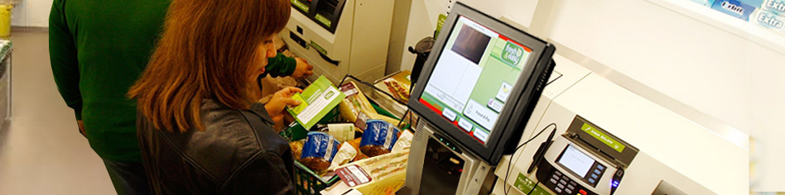
provide a mechanism for customers to complete their own transaction from a retailer without needing a traditional staffed checkout
What is Self-Checkout System?
used mainly in supermarkets, department or convenience stores

Slide 5
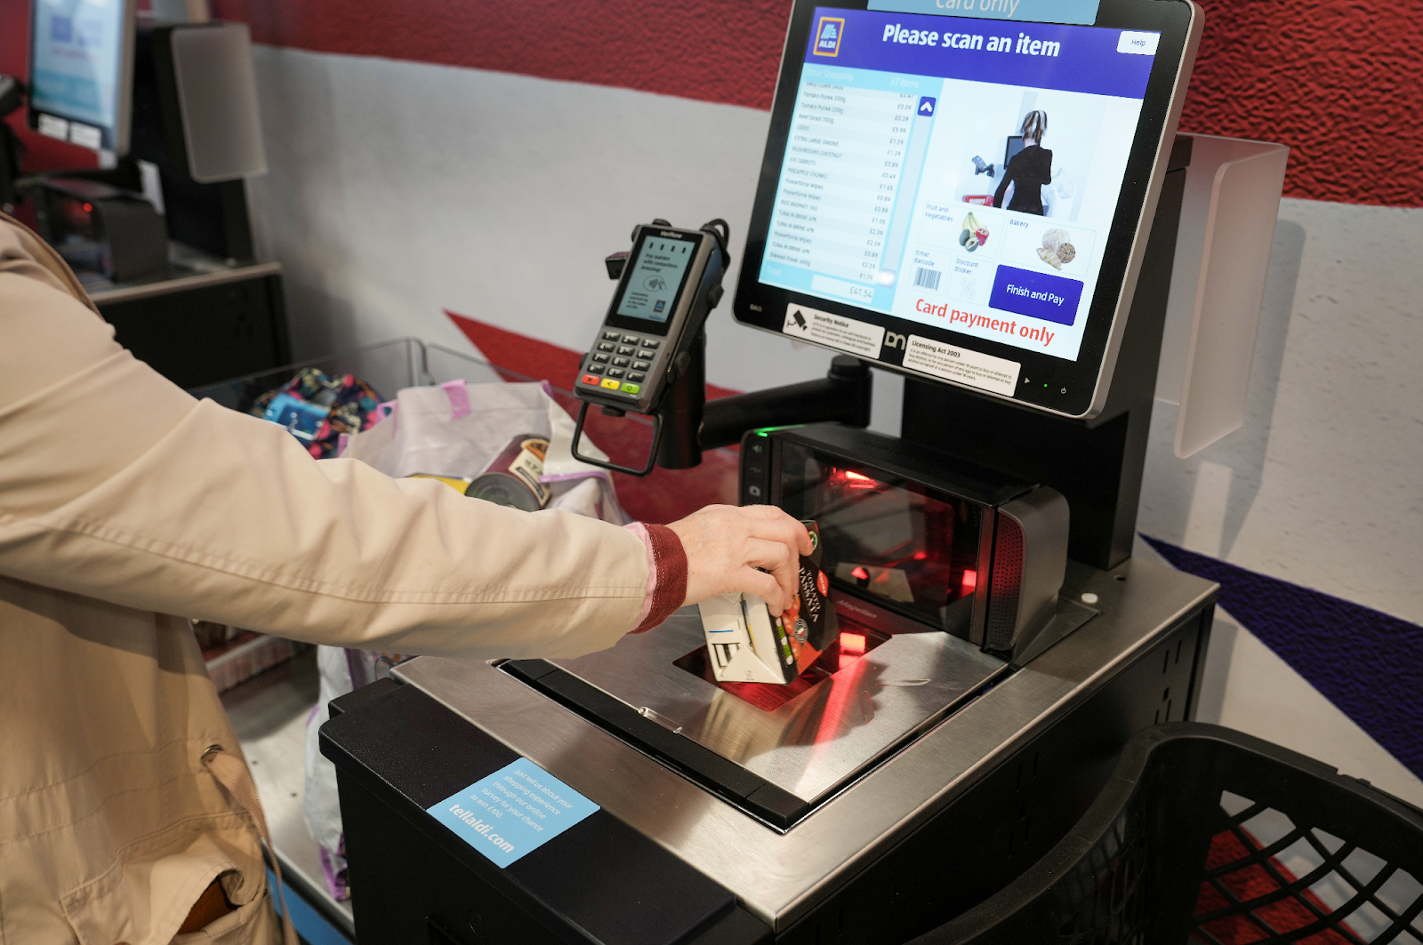

Customer
scan, bag, and pay for their products without the assistance of a cashier
no longer need to wait in line to pay for their products especially for those who only want to buy a few things
can use majority of payment methods, such as credit cards and E-Wallet, which can be completed in a matter of seconds using this technology
Management
can reduce part of the store's cost of hiring cashiers
save a sum of money to improve the shopping environment for customers in the store, and attract and retain more customers.

Slide 6
Synopsis and General Idea
02

Slide 7

Customer
Print a receipt listing the list and quantity of all items purchased by the customer
List the total price of all items and the tax paid
Display the customer’s existing member points based on the entered member ID
Calculate the amount of discount if voucher code is applicable

Slide 8

MANAGEMENT
Transaction
Data
Type of discount that applied
the payment method used
the time and date of the transaction
the items purchased
From the transaction data, the management can
identify popular products
purchasing trends, and peak shopping periods
improve inventory management processes
detect slow-moving items
better estimate demand and modify inventory levels
prevents overstocking or stockouts

Slide 9
EXPECTED OUTPUT
03

Slide 10
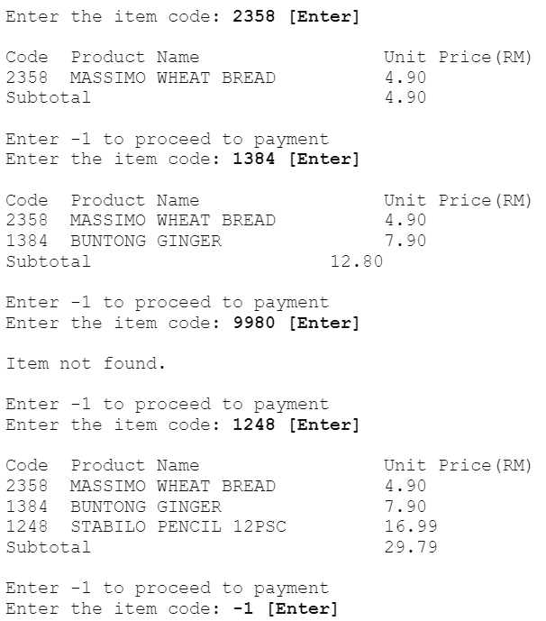
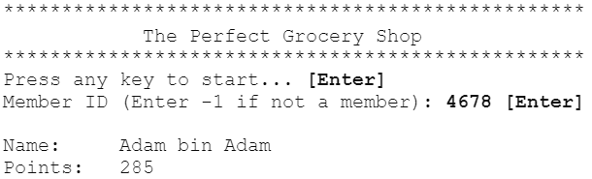
CUSTOMER VIEW
2. User enter item code purchased and
enter -1 to proceed to payment
1. Prompt the user to enter member ID

Slide 11
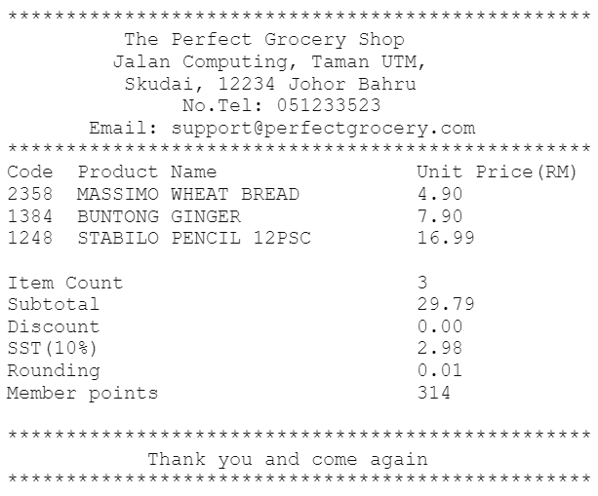
3. Display the receipt for user after making payment

Slide 12
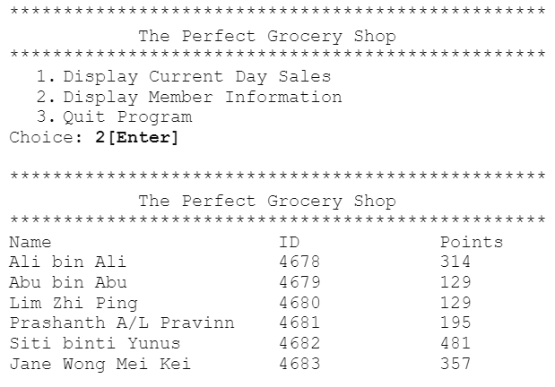
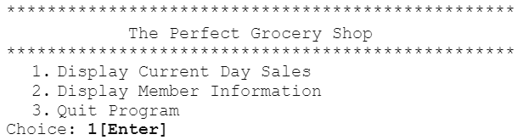
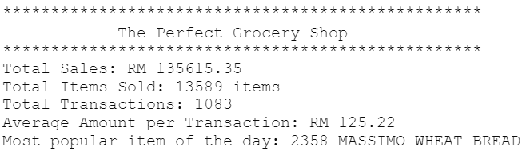
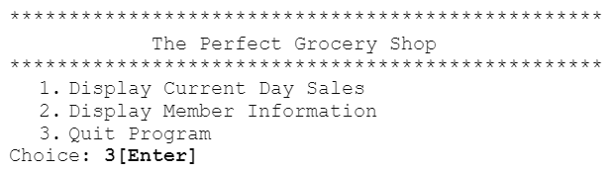
MANAGEMENT VIEW
3. Choice 2
1. Display the function choices
2. Choice 1
4. Choice 3 (to exit the program)

Slide 13
STORYBOARD
04

Slide 14
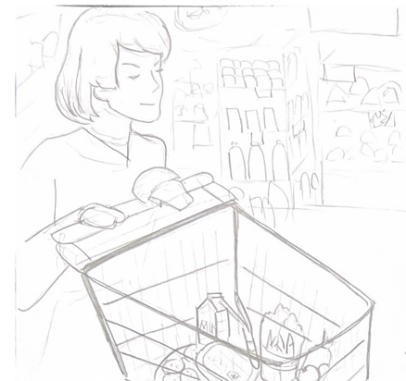
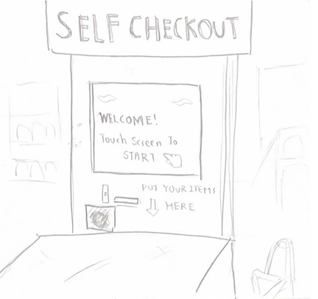
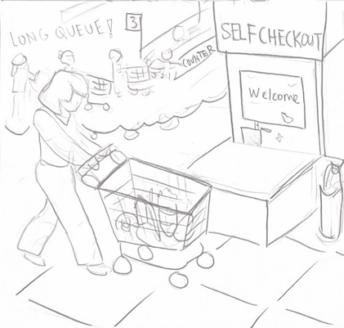

Slide 15
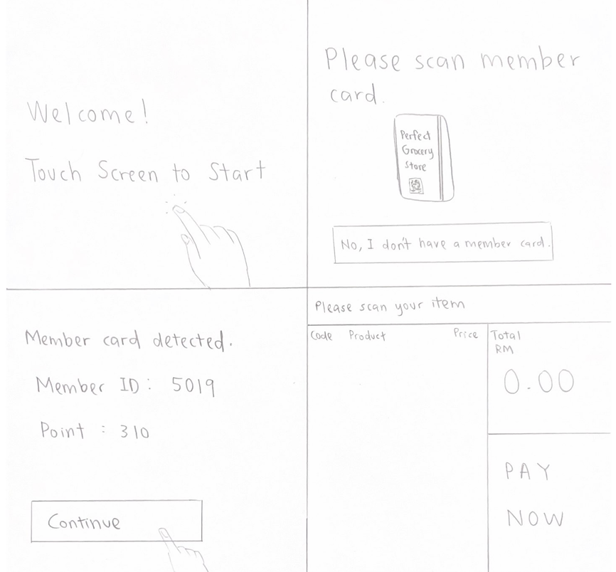

Slide 16
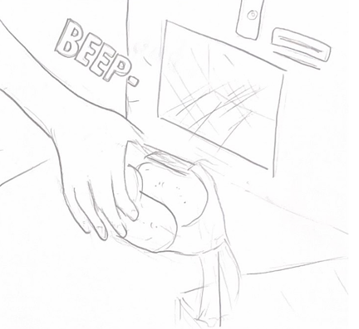
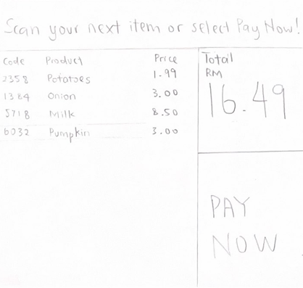
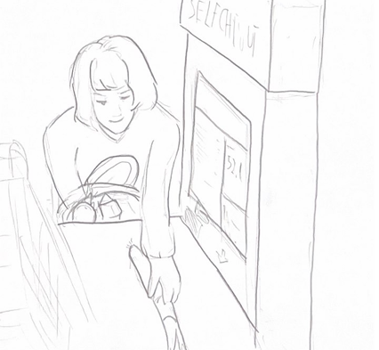

Slide 17
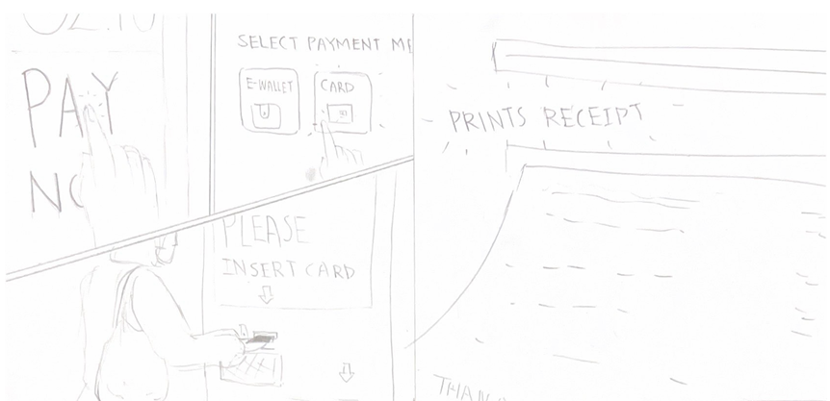
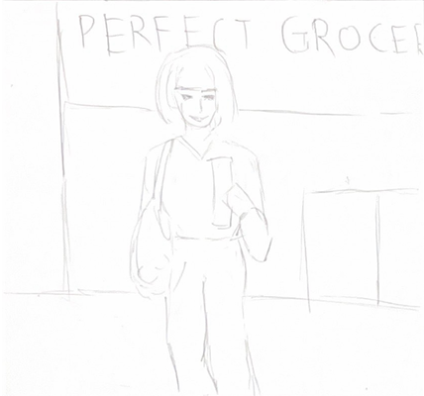

Slide 18
CONCLUSION
05

Slide 19
revolutionize the checkout process by integrating seamlessly designed features
ensures smooth operation and enhanced efficiency
optimize cashier productivity and elevate customer satisfaction through intuitive interfaces and automated functionalities

Slide 20
POSSIBLE IMPROVEMENT
06

Slide 21
THANK YOU

